Slide 1
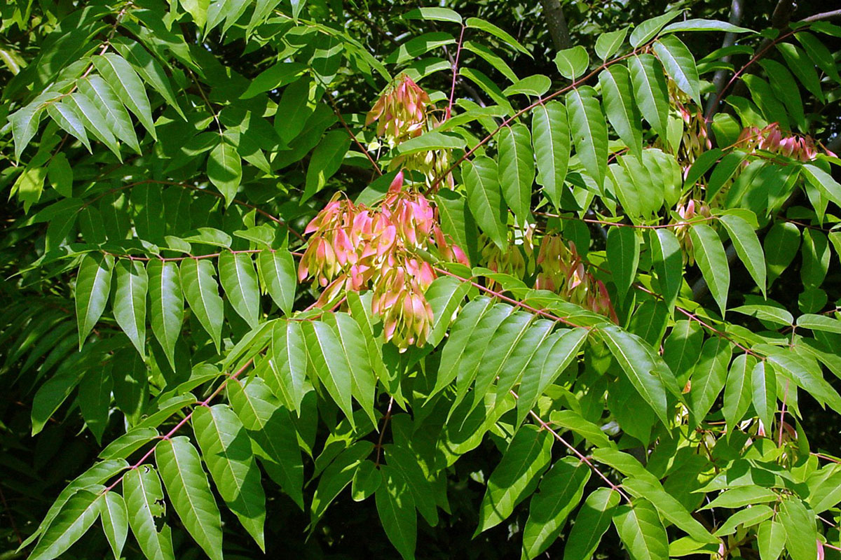
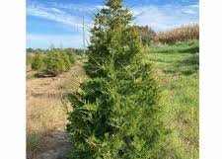

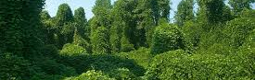
Module 12: Ecology and Effects of Invasive Species on Forest Soils

Slide 2
Topics We’ll Cover…
Terminology and basics of invasive species ecology
Ecology and history of selected invasive woody species
Impacts of invasive species on native forest ecosystems with emphasis on soil health
Allelopathy and inhibition
Legacy effects

Slide 3
What do these terms mean to you?
Noxious
Invasive
Exotic
Weed

Slide 4
Let’s define and clarify those terms now
Noxious. A noxious weed, harmful weed or injurious weed is a weed that has been designated by an agricultural or other governing authority as a plant that is injurious to agricultural or horticultural crops, natural habitats or ecosystems, or humans or livestock.
Invasive. An invasive species can be any kind of living organism—an amphibian, plant, insect, fish, fungus, bacteria, or even an organism’s seeds or eggs—that is not native to an ecosystem and causes harm.
Exotic. An exotic species refers to a plant species or an animal species that is non-native. It is introduced into an area where it does not occur naturally.
Weed. A weed is a plant growing in the wrong place. Also, it is a wild plant that is growing in competition with a cultivated crop, lawn or pasture.

Slide 5
Examples
Common cocklebur – native, weed that is noxious (listed in Arkansas & Iowa).
Groundsel (salt bush) – native and a weed in the U.S. but invasive in Australia, Spain & New Zealand (regulated in all 3 as noxious).
Soybeans – exotic but not invasive or noxious – major agronomic crop.
Pheasants – exotic and naturalized in the U.S. but not considered invasive
Cogon grass – exotic and invasive (sold as Japanese blood grass).
Tomato – exotic but not invasive or noxious (and good to eat).

Slide 6
What has happened in the ecosystem to make it favorable for invasion?
Usually, the ecosystem has experienced disturbance.
Typically, the disturbance is human induced; logging, ag clearing, development, landscape/ornamental introductions, global plant trade, etc.
Resources are made available, sunlight, water, nutrients and bare soil.
Native ecosystems lack the predators, enemies, and diseases that would normally keep the invasive species in check.
Climate can also facilitate the spread of many invasive species.
Notes:
Why do these mechanisms matter in relation to soil health? Next slide….tell the story.

Slide 7
The implications for forest soil health
Humans are causing major shifts in biological communities.
There is an aboveground and belowground context to consider.
In forest ecosystems, the belowground effects are often negative on soil detritivores, fungi, etc.
Invasives pre-condition forest soils to the detriment of natives.
Example: mycorrhizal associations are disrupted.
Notes:
We can often see the aboveground shifts in biotic communities. The belowground changes are not easily seen with the naked eye.

Slide 8
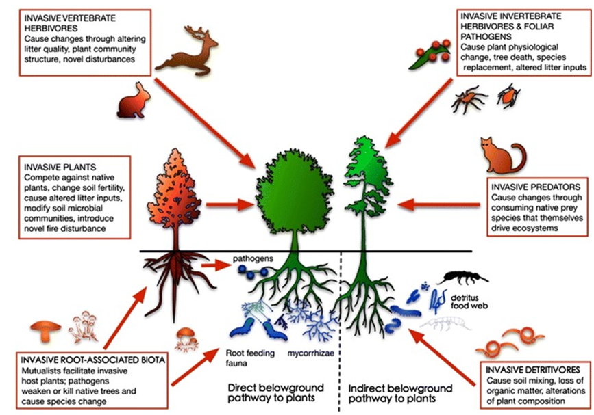
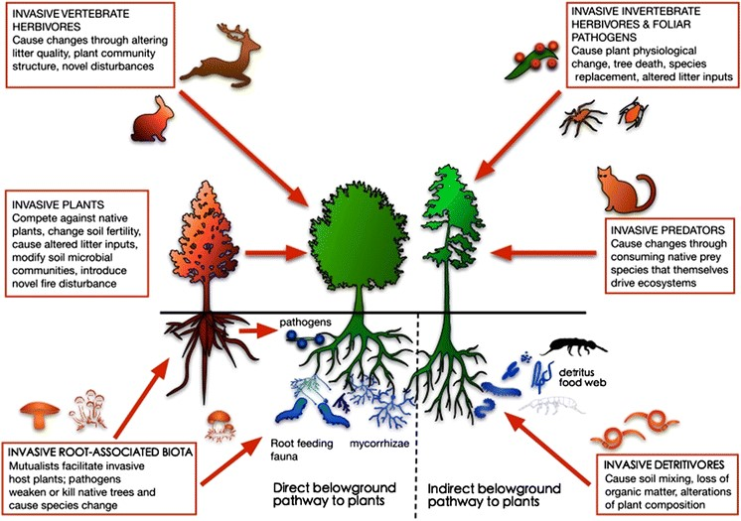
Linkages of above and belowground biota
(Wardle and Peltzer 2017)
Notes:
There are direct and indirect pathways in forest ecosystems that drive ecosystem function. Invasives disrupt these linkages. Slides 8, 9 and 10 are related.

Slide 9
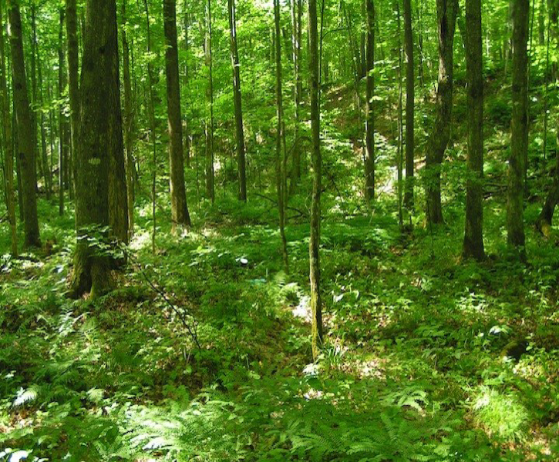
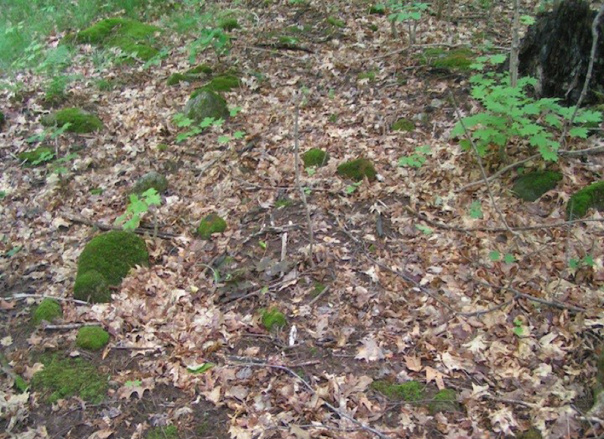
Linkages of above and belowground biota (Wardle and Peltzer 2017)
Minnesota Hardwood Forest
NO earthworm invasion
YES earthworm invasion
Notes:
Effects of invasive earthworms in a Minnesota hardwood forest. This illustrates the effect of below ground organisms and accelerated nutrient cycling. 23% of earthworms in North America are invaders.

Slide 10
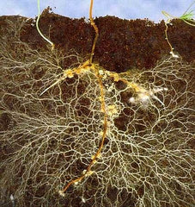
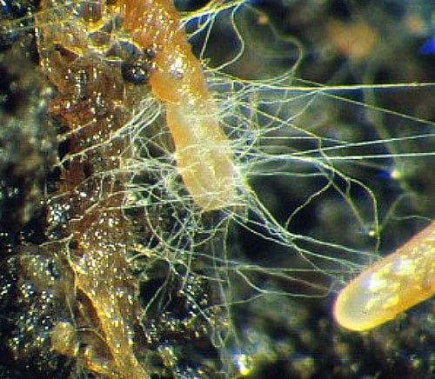
Linkages of above and belowground biota (Wardle and Peltzer 2017)
Mycorrhizal fungi on tree roots
Notes:
Arbuscular mycorrhizal fungi tend to mitigate the effects of allelochemicals by invading plants. We will talk more about allelochemicals later.

Slide 11
The Asia connection is similar for many species
Chinese privet
Japanese privet
Japanese climbing fern
Japanese honeysuckle
Chinese tallow tree
Japanese wisteria
Japanese barberry
Asian long-horned beetle
Chinaberry tree
Tree of Heaven (China)
Cogon grass (Japanese bloodgrass)
Japanese stiltgrass
What are some common invasive plants in Western forests?

Slide 12
Important links to invasive species information
Southern Forest Futures Project - Excellent baseline data on invasive species.
Early Detection and Distribution - University of GA - Current data and interactive map.
Western species links?...

Slide 13
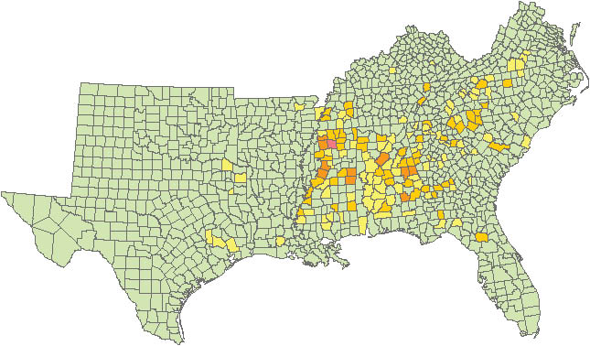
Kudzu distribution map for the Southeast
USDA/USFS, Southern Forest Futures Project, 2012

Slide 14
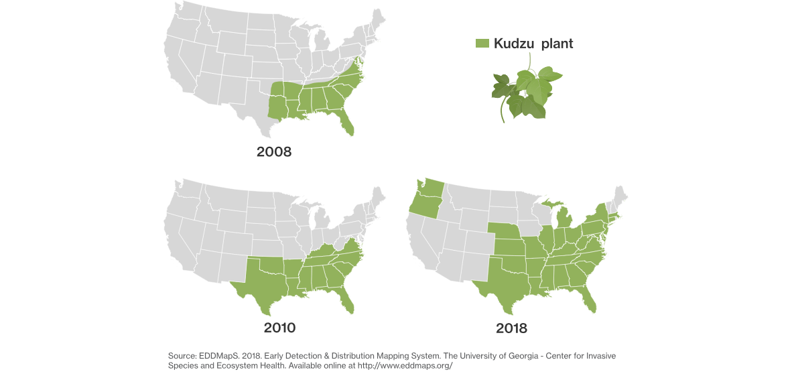
Spread of Kudzu: 2008-2018
Notes:
Most source agree that kudzu impacts around 7.4 million acres of land today.

Slide 15
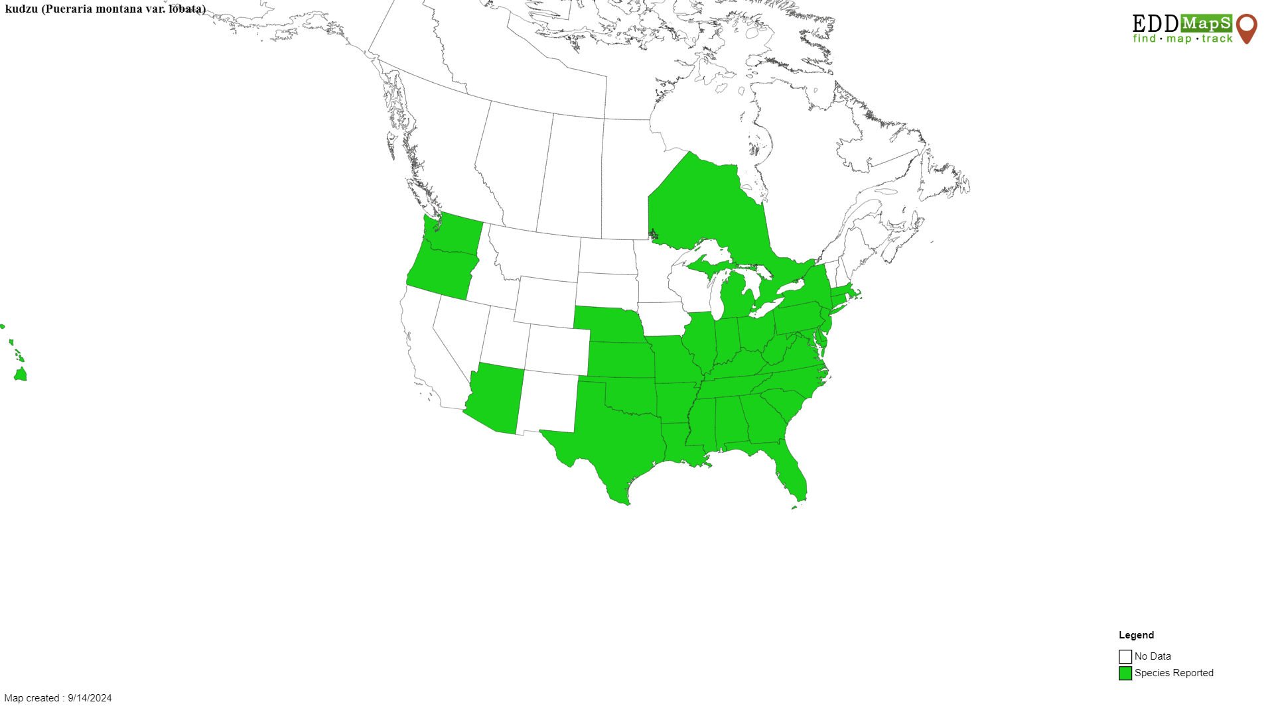
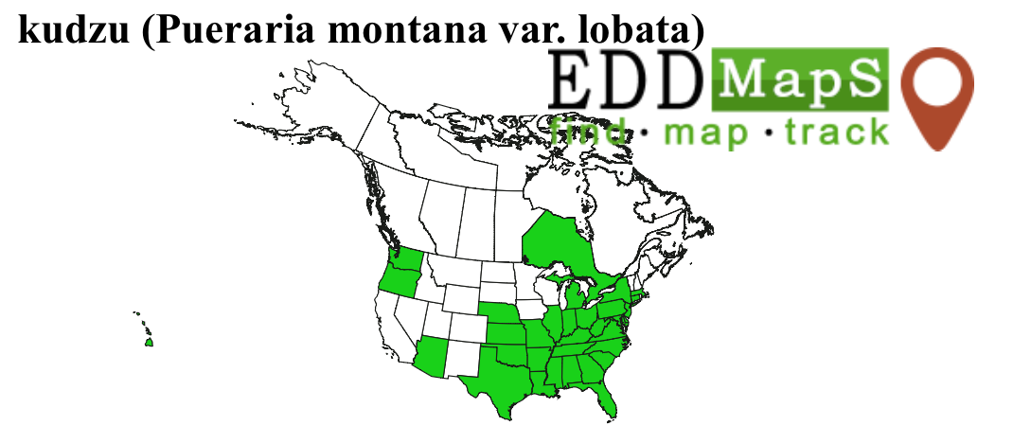
Current Kudzu Distribution
Notes:
Current map of kudzu distribution …..not northward spread. From UGA – EDD website

Slide 16
Species-based mechanisms
Fast growth rate
Rapid reproduction rate
Highly efficient dispersal ability
Tolerance for a wide range of environmental conditions
Allelopathy
Notes:
Add graphic on allelopathy……define relationship to soil health…….see next slide.

Slide 17
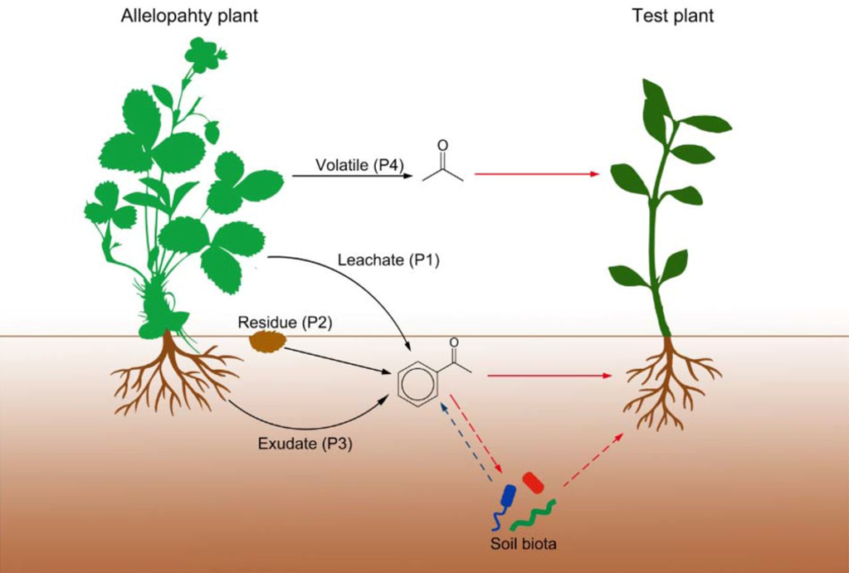
Allelopathy – pathways into the soil
(Wardle and Peltzer 2017)
Notes:
Fog, rain, dew etc. contribute to the volatilization of most allelochemicals. Root exudates from invasives help invasives create a favorable environment to exclude native spp.

Slide 18
Allelochemicals
Secondary products or metabolites which are low molecular weight compounds.
Can be degraded or activated by microbial action.
Phenolics, terpenoids, glycosteroids and alkaloids are the main groups that are bioactive.
They interact with the surrounding environment to prevent or inhibit germination of native species.
Released by volatilization, leaching, root exudation, and decomposition.
Notes:
There are 100,000 secondary metabolites, and there are 8,000 phenolics. Complex interactions are the norm and not all have been studied.

Slide 19
The Rhizosphere – importance and soil health
Soil is the greatest reservoir of microbes that affect plant growth, fitness, fecundity, and stress tolerance.
All plant-soil feedbacks point directly to the rhizosphere microbiome, in its entirety, as the primary mediator of plant establishment and success (Ehrenfeld, 2003; Ehrenfeld et al., 2005; Bever et al., 2012).
Invasive plants provide a unique perspective to study the effects of the rhizosphere microbiome on plant fitness, the role evolutionary interactions play in structuring the plant ecology observed at present, and the potential for directed control and management of invasive plants.
Notes:
References are available on these topics. This is very relevant to soil health. We should be just as concerned about the rhizosphere’s function as we are about the above ground portion of a forest.

Slide 20
Effects on soil health - studies
The amount of an allelochemical or its concentration released to the soil is difficult to measure.
Appropriate assays must be used to measure inhibitory effects of allelochemical.
The soil-root interface is considered the site of greatest activity of these compounds.
The biochemical interactions in the rhizosphere are among the least studied.
Allelopathic interference is well documented in lab studies, but it is harder to assess in field conditions.
Notes:
Recent research studies show……these are findings gleaned from some 25-30 papers

Slide 21
Examples of Species-based mechanisms
Fast growth rate – Kudzu is called “mile a minute vine” – grows 1 ft/day
Rapid reproduction rate – Baccharis spp. produces 250K – 1M seeds/plant
Highly efficient dispersal ability – wind, water, vehicles, animals
Tolerance for a wide range of environmental conditions – salinity, temperature
Ability to shift metabolism to tolerate drought – Tree of Heaven
Notes:
Each invasive species has its own unique method that makes it successful.

Slide 22
Impacts of invasive species
49% of T & E species in the U.S. are at risk because of invasive species.
Contributes to loss of biodiversity worldwide.
75% of invasions occur in forests and woodlands worldwide.
Threatens food security in some places.
Aesthetics – Dutch Elm disease killed half the elm trees in the Eastern U.S.
Economics – globally 423 billion $$$ are spent each year to control invasives.

Slide 23
C:N ratios and litter decomposition
Native tree species: oak leaves, 60:1 C:N ratio; maple leaves 30:1 C:N ratio
Invasive woody species: Chinese privet, 15:1; Tree of Heaven, 20:1 C:N ratio
When Chinese privet makes up 30% or more of midstory, the C turnover is 260% greater than native forest alone (Mitchell et al 2011).
Summertime mineralization of N with privet present is 5 X greater than without.
Privet leaves have lower lignin content; they decompose faster.
Notes:
Increase in N is like adding fertilizer to the system.

Slide 24
Legacy effects of plant invasion
Definition: Effects that persist after the biotic interaction that caused the effect ceases.
In practice: How long does the negative effect last in the soil following invasion?
Why: Legacy effects can hinder recovery of native forest communities.
The concept of legacy effect was introduced in ecological research in the 1990’s (Cui et al 2024).
Nitrogen deposition and allelochemicals contribute to legacy effect (Torres et al 2021).
Notes:
Bacteria feed on the increased N from the invasives. Bacterial diversity is usually increased (short term). How does legacy affect restoration/recovery efforts? Most systems will recover from legacy effects given enough time; do we know how to conduct restoration to shorten the time for natives to return?

Slide 25
Sustaining forest soil health and productivity
Globally, invasive species are second to land use change in disruptive impacts on ecosystems (Prior et al 2018).
1,000 years ago, forests covered 44% of the earth; today the area is 30%.
Forests harbor most of earth’s terrestrial species.
Forests are responsible for 75% of the world’s primary production.
In many regions of the world, forest invasions constitute a “megadisturbance” that is fundamentally changing the properties of the forest (Liebhold et al 2017).
Notes:
See USFS paper….. Deborah S. Page-Dumroese , Matt D. Busse , Martin F. Jurgensen and Eric J. Jokela…..2021

Slide 26
Easy to recognize in the forest
Many of our forest invasive plants green up a few weeks prior to our native/natural occurring species.
    Chinese Privet – We will talk about this one briefly on the next few slides
    Autumn Olive
    Bush Honeysuckle
    Tree of Heaven
Can you name some Western forest invasives?
Notes:
Slides 26-38 will illustrate ecology of one selected species……the presentation can be delivered in 45 minutes.

Slide 27
Chinese privet – Ligustrum sinense
One of the worst invasive species in the SE United States.
Colonized by root sprouts and seeds spread by bird/animals/wind.
Shallow roots that sprout when it is cut or top killed.
Minimize soil disturbance in areas with privet.
Treat when young to prevent seed formation.
Repeat applications commonly required for control.

Slide 28
Chinese privet ecological traits
Outcompetes native vegetation easily.
Displaces entire understory and/or midstory layer in a forest.
It adapts to varying light levels easily – larger ramets in shade.
It reproduces sexually and asexually – seeds and suckers.
It has tree-like and shrub characteristics.
It thrives on floodplain and riparian sites.

Slide 29
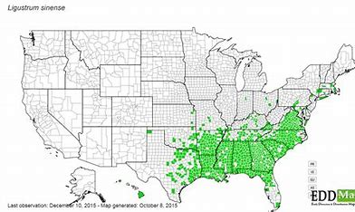
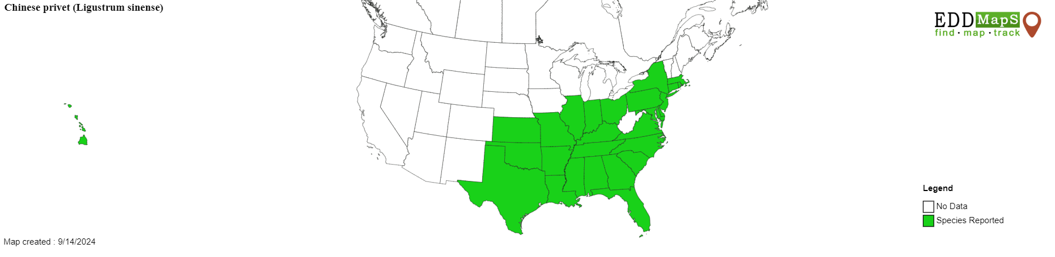
Distribution map – Chinese privet
Notes:
EDDMapS. 2024. Early Detection & Distribution Mapping System. The University of Georgia - Center for Invasive Species and Ecosystem Health. Available online at http://www.eddmaps.org/; last accessed September 14, 2024.

Slide 30
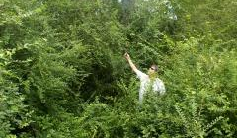
Chinese Privet
Chinese privet characteristics
Grows to 20 feet tall.
Shades out midstory in native forests.
Prevents natural regeneration of trees.

Slide 31
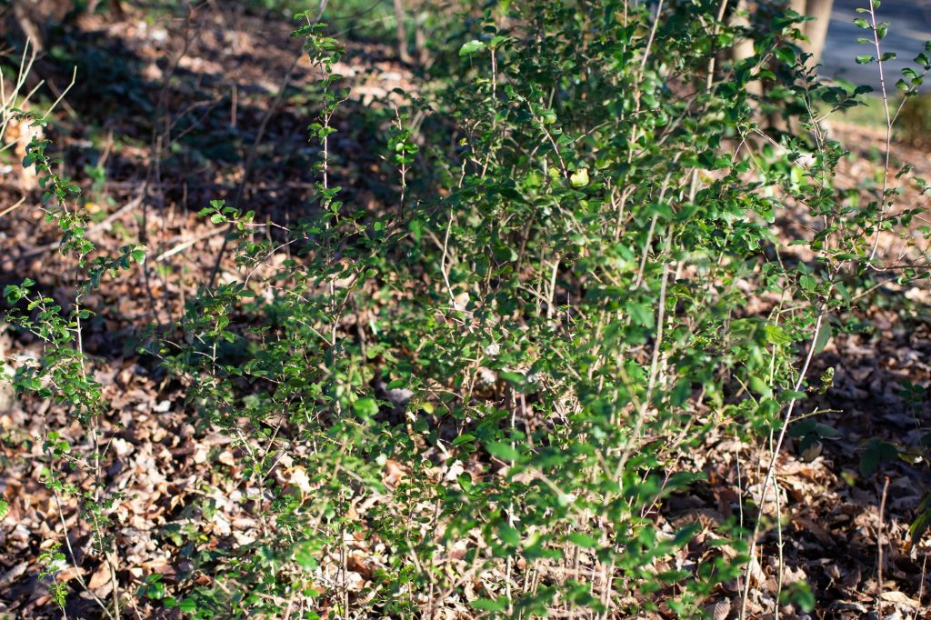
Chinese privet root suckers

Slide 32
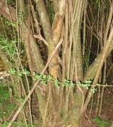
Chinese Privet – typical multi-stemmed growth habit
Chinese privet multiple stems
When left unchecked, develops dense thickets with many trunks coming from a common root system.

Slide 33
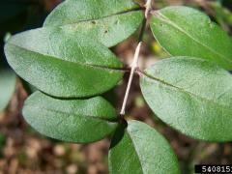
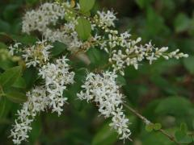
Chinese Privet – typical multi-stemmed growth habit
Chinese privet flowers and foliage
Opposite leaves, 1-2.5 inches long
Flowers occur April to June
When left unchecked, develops dense thickets with many trunks coming from a common root system.

Slide 34
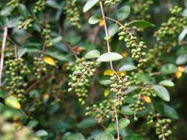
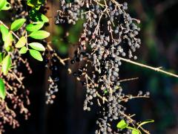
Chinese privet fruit (toxic to humans)
Unripe - green
Ripe – purple to black - .5 inch long
When left unchecked, develops dense thickets with many trunks coming from a common root system.

Slide 35
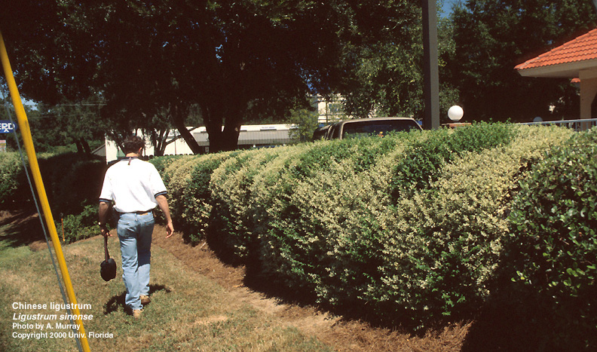
Privet hedge in flowering – urban setting

Slide 36
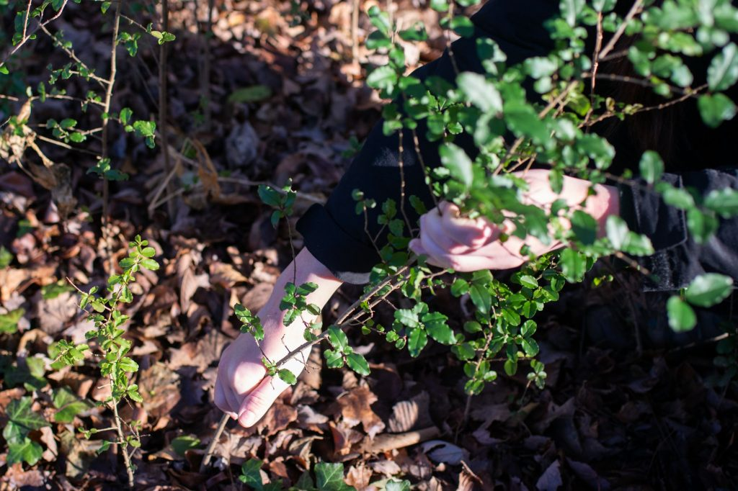
Removal by hand when small

Slide 37
More bad news about privet
There are 9 species of Ligustrum in the Southeast U.S.
Currently, Chinese privet occupies 2.4 million acres of land in the SE.
Chinese privet is considered a foreign invasive in AL and GA.
Privets were introduced as ornamentals into the US in the late 1700’s.
Models indicate increased CO2 will cause privet to proliferate.
Prescribed fire does not help with control of privet.

Slide 38
My participation with research
Graduate school – 1995-96 – University of Memphis.
Flood – shade factorial design experiment with Nuttall oak led to similar experiment with Chinese privet.
C. E. Brown, R. Pezeshki (2000) "A Study On Waterlogging as a Potential Tool to Control Ligustrum Sinense Populations in Western Tennessee." Wetlands 20:3, September 2000.
Short term flooding and shading does not kill privet.

Slide 39
Thank you!
For more information on Managing Soil Health,
visit us here:
https://www.nrcs.usda.gov/conservation-basics/natural-resource-concerns/soils/soil-health
USDA is an equal opportunity provider, employer, and lender.

